Slide 1
Forecasting of Groundwater Levels in a California Aquifer.

Slide 2
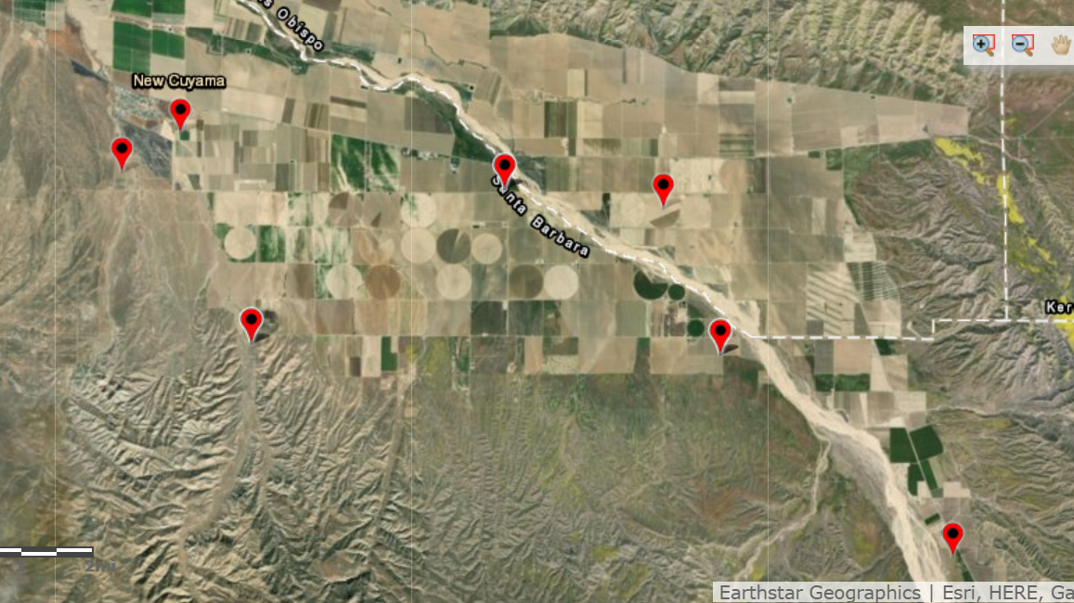
How well can an empiric model forecast the Water level for a series of wells in a California Agricultural Area?
When trying to predict the well’s water level one year in the future, is a Machine Learning Model more accurate than a Time Series Model?
What are the main factors affecting the water level in the Cuyama Basing Aquifer?
Wells Location in the Cuyama Basin Aquifer (Santa Barbara and San Luis Obispo Counties)

Slide 3
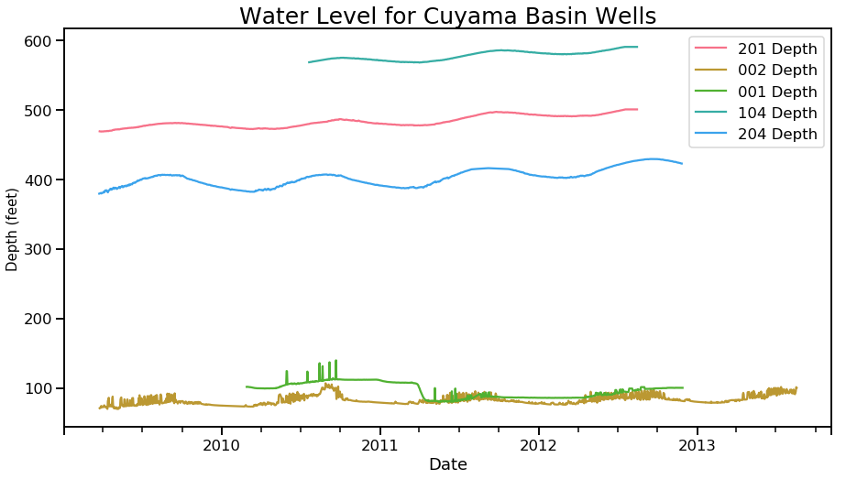
Groundwater level’s Data
There are available daily measures for 5 Wells in the Cuyama Basin.
Data for wells 001 and 002 has many outliers.
Data for Wells 201, 104 and 204 doesn’t seem to have outliers. I am going to use these 3 wells to create my models.
I will forecast the water level one year in the future. I calculated the water level Delta Y:Y and I will use that metric as the target variable for my models.

Slide 4
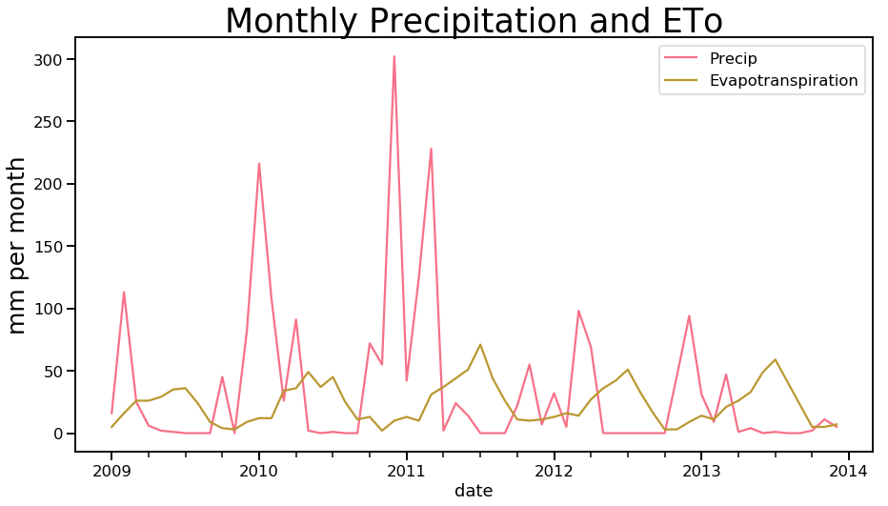
Climate Data
An underground aquifer is an open system, the variations on water levels are dependant on the relation between inputs and outputs.
The main input is the precipitation over the region. The main output is water pumping, however a fraction of the pumped water filters back into the aquifer. The amount of water that escapes depends on Evapotranspiration (Eto).
Evapotranspiration depends on climate conditions (mainly temperatures and solar radiation)
Notes:
Eto is defined as the process by which water is transferred from the land to the atmosphere by evaporation from the soil and other surfaces and by transpiration from plants.

Slide 5
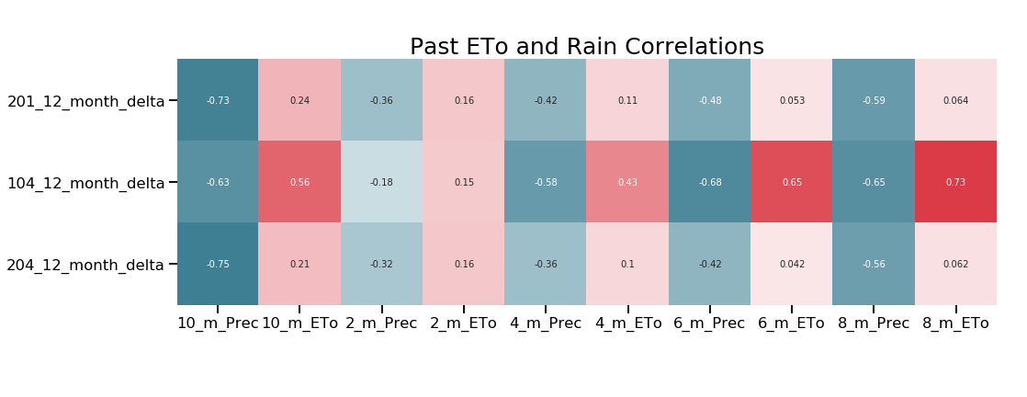
Climate Data Featuring Engineering
Precipitation: how much rain filters into the ground depends on the total amount of precipitation, but also in the distribution of that precipitation.
ETo: the temporal distribution of the ETo is also going to affect the water output.
The past Precipitation and ETo will also affect the ground water transfer dynamics and the water levels.

Slide 6
Machine Learning Models
I compared two different Machine Learning Algorithm: Random Forest and Gradient Boosting.
I used Grid Search to fine-tuning the parameters for both models.
Time Series Model
I used an ARIMA Model to forecast the water level.
I compared several ARIMA models with different parameters combination to find the best configuration.
Models Comparison:
In order to find the best method, I model one of the wells (#204) using 3 different techniques.
To compare the model against each other, I will use data for 4 measures collected during the year after daily data was not collected anymore.
Once I have a winner model, I will use to forecast the Water levels for wells 201 and 104.

Slide 7
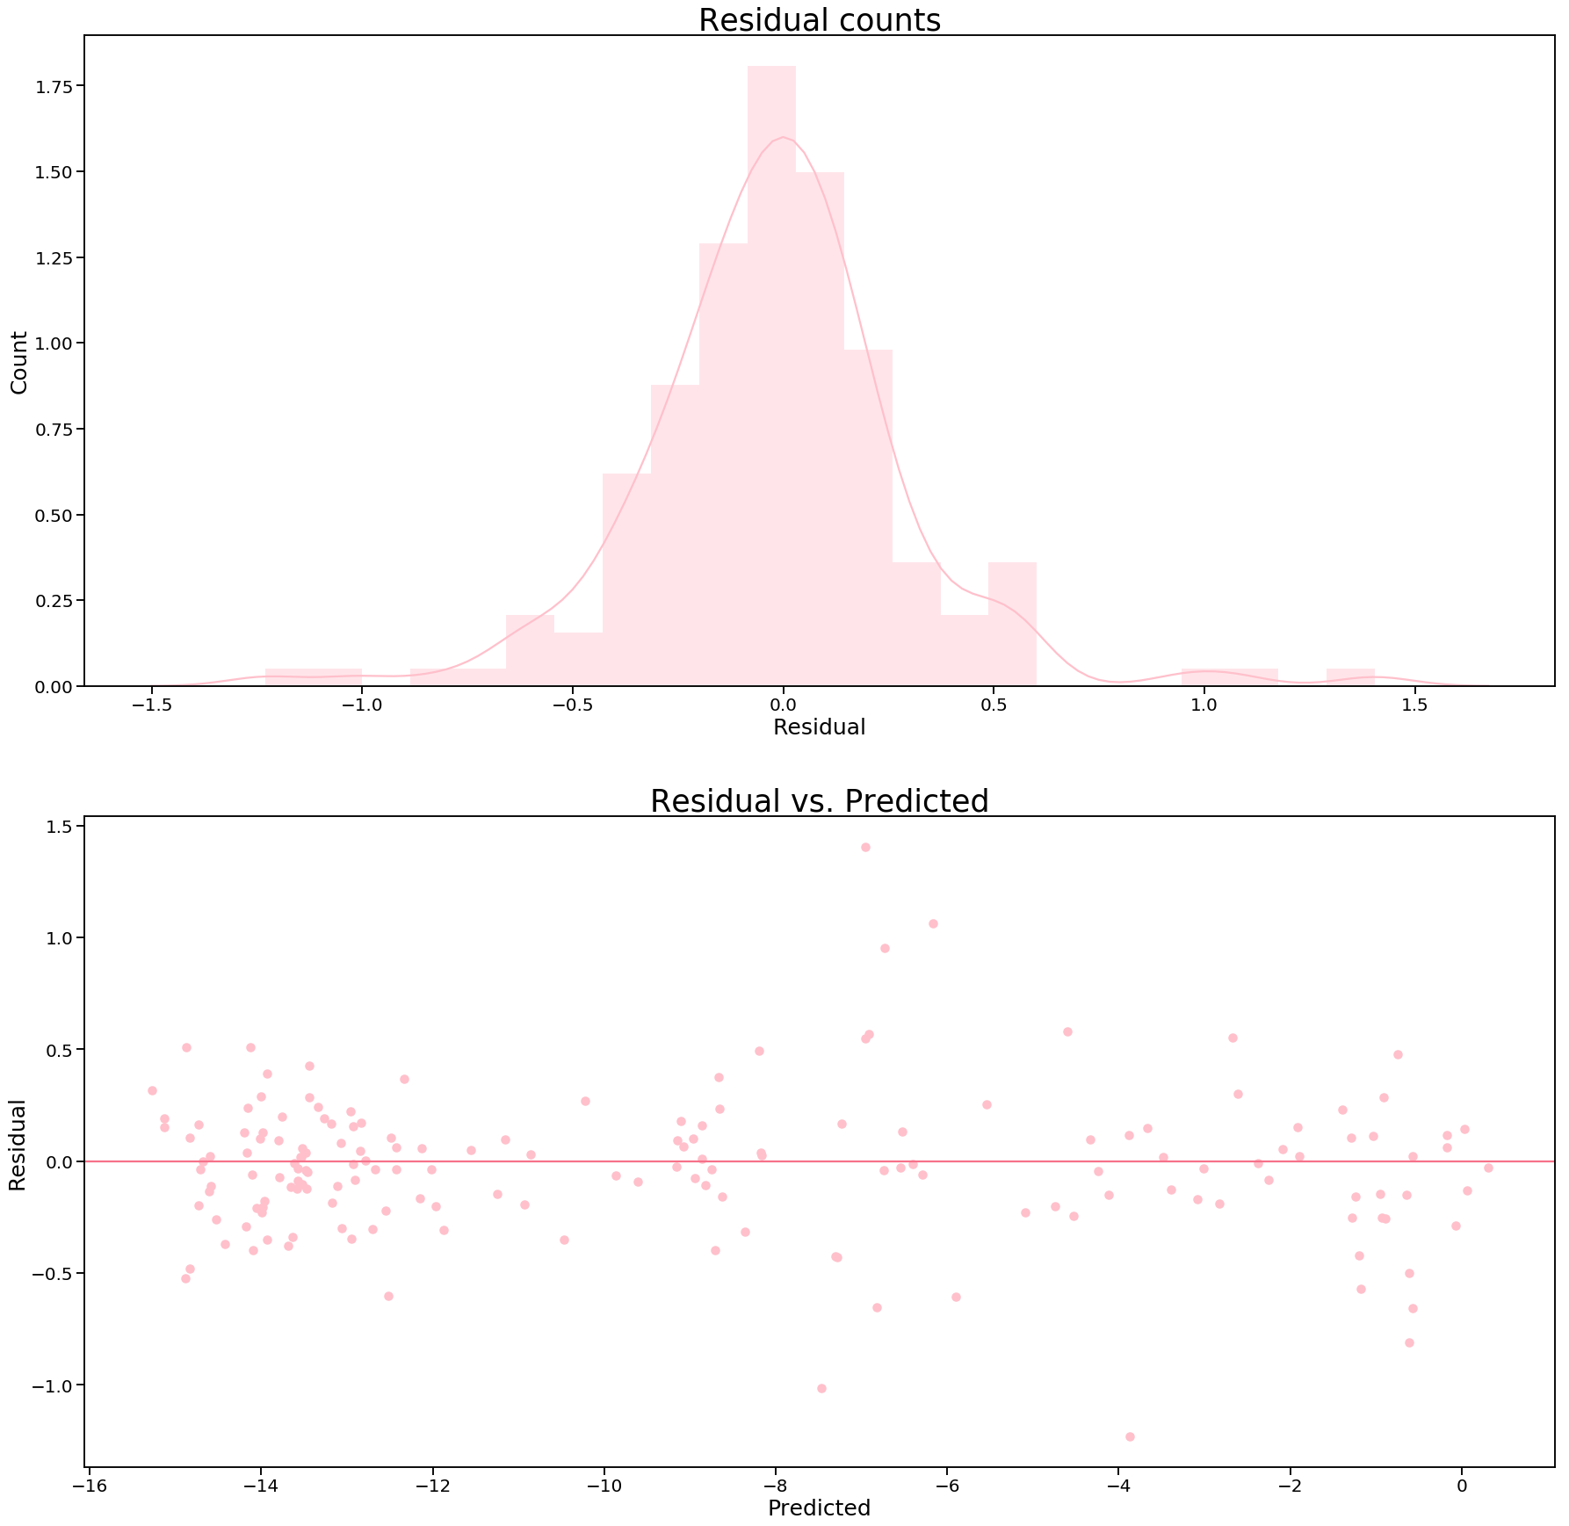
Machine Learning Models
Gradient Boosting performed better than the Random Forest model (when comparing Mean Squared Errors).
Our Gradient Boosting Model was able to explain 99.47% (+/- 0.05%) when using CV with 5 folds.
When using the model to forecast the water levels for the Holdout data (20% of the data), the error from the model is normally distributed.

Slide 8
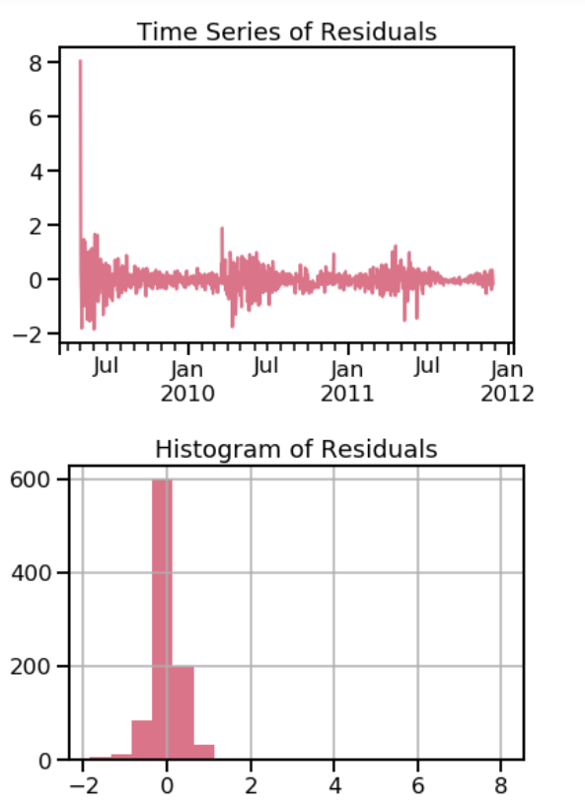
Time Series
I compared several ARIMA models with different parameters to find the best configuration.
The best results were achieved by an ARIMA(1,1,1).
The distribution of error is consistent for all predicted values.
I used this model to Forecast the water depth during the following 365 days, and the I selected the predictions for the 4 days I have measurements.

Slide 9
Comparing the results for both models (Well 204)
Date | Previous Year Depth | Delta | Actual Depth | GB Forecast | TS Forecast
2012-11-27 | 409.69 | 12.83 | 422.52 | 422.57 | 422.62
2013-03-21 | 402.86 | 13.44 | 416.30 | 418.04 | 417.49
2013-05-30 | 414.54 | 9.87 | 424.41 | 428.01 | 430.21
2013-11-21 | 423.43 | 7.54 | 430.97 | 436.53 | 441.69
The GB Model did a better job of forecasting the water levels for all samples but one.
The Mean Square Error for GB was lower than the achieved by the TS Model (11.59 vs 37.51)
I am going to use the GB Model to forecast the water level for wells 201 and 104.

Slide 10
Machine Learning Results forecast for Wells 201 and 104
Date | Previous Year Depth (201) | Delta | Actual Depth | GB Forecast
2012-08-16 | 492.90 | 11.14 | 504.04 | 500.42
2012-12-03 | 493.80 | 10.60 | 504.40 | 505.92
2013-03-21 | 490.68 | 10.87 | 501.65 | 503.87
2013-05-30 | 494.17 | 11.49 | 505.68 | 506.96
Date | Previous Year Depth (104) | Delta | Actual Depth | GB Forecast
2012-08-16 | 581.16 | 13.37 | 594.53 | 589.93
2012-11-29 | 583.39 | 12.66 | 596.05 | 593.86
2013-03-26 | 580.57 | 12.35 | 592.92 | 593.11
2013-06-13 | 586.1 | 12.88 | 598.98 | 598.28

Slide 11
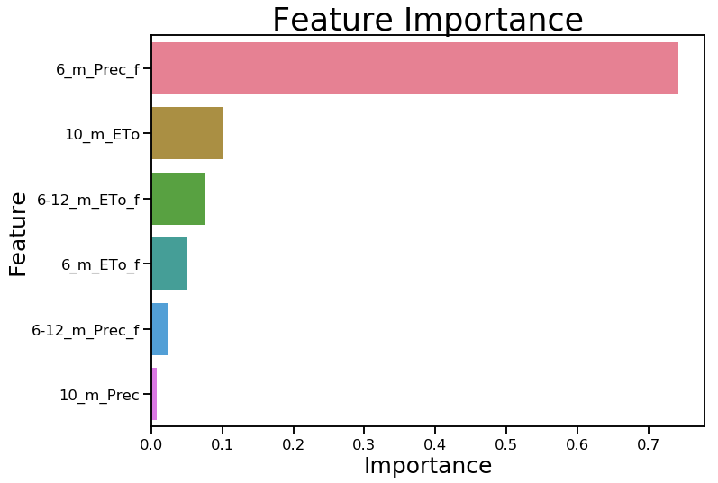
Feature Importance for Well 201
Out of the 6 features used to predict the well water levels, the amount of precipitation during the next 6 months was the most important one with over 70% of the weight.
The second most important feature was the amount of ETo during the previous 10 months.

Slide 12
Conclusions
Practical use of the model:
For Irrigation Communities managers, the model could help them make decisions about resources optimizations during the next growing season. In California there is a Water Future Market, the model could help Irrigation Communities evaluate if they would need to buy water rights or if they can sell those rights to have an extra income.
For long term planning, the model could also help understand what are the most important factors affecting the amount of available groundwater in the future.
Weak Points:
With more resources available, I would have tried to obtain satellite images of the basin during the time-series to simulate the amount of water used for irrigation and create a new feature.
When predicting water level in the future, using a climate model that can estimate the probability of different climate conditions, so the results could be calculated as a distribution of probabilities.

